Slide 1
Volume of prisms
Perimeter, area and volume

Slide 2
how to use Oak lessons

Slide 3
I can use the constant cross-sectional area property of prisms to determine their volume.

Slide 4
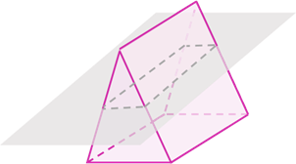
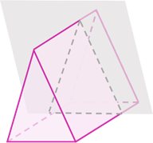
A cross-section is a 2D face made from cutting straight through any plane of a 3D object.
A cross section of a prism made parallel to the base will be congruent to the base.
The volume is the amount of space occupied by a closed 3D shape.

Slide 5

Volume of prisms
Calculating the volume of any prism
Using the volume of a prism

Slide 6
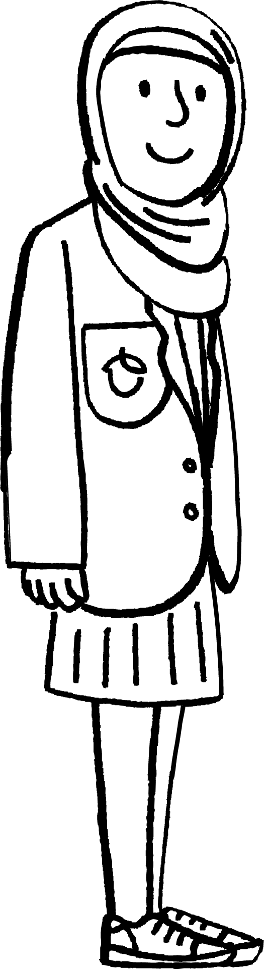
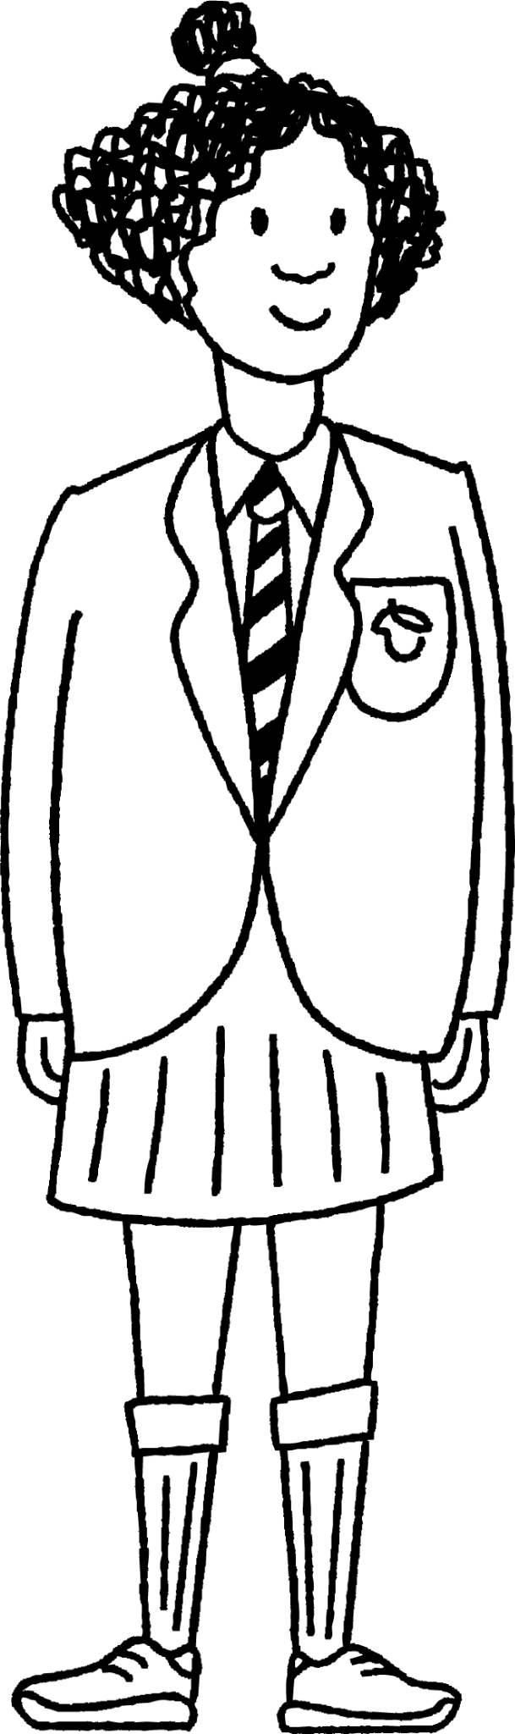

Calculating the volume of any prism
Aisha and Izzy’s teacher gives them 24 cube blocks and tells them to create a cuboid using all of the blocks.

Slide 7
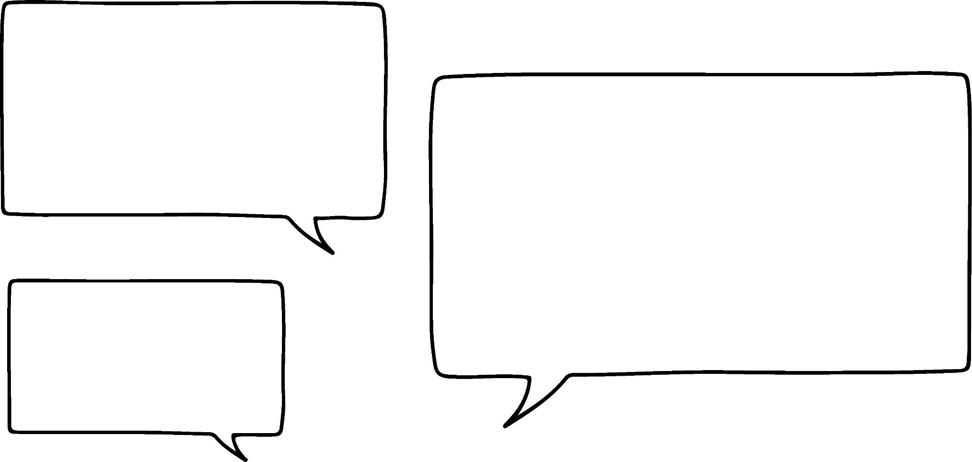
Calculating the volume of any prism
Aisha and Izzy’s teacher gives them 24 cube blocks and tells them to create a cuboid using all of the blocks.
Is that the only way we could have done it?
I think I can see another way.

Slide 8
Calculating the volume of any prism
Aisha and Izzy’s teacher gives them 24 cube blocks and tells them to create a cuboid using all of the blocks.
I think I can see another way too.

Slide 9
Calculating the volume of any prism
Aisha and Izzy’s teacher gives them 24 cube blocks and tells them to create a cuboid using all of the blocks.
Are there any more cuboids that can be made out of 24 cube blocks?

Slide 10
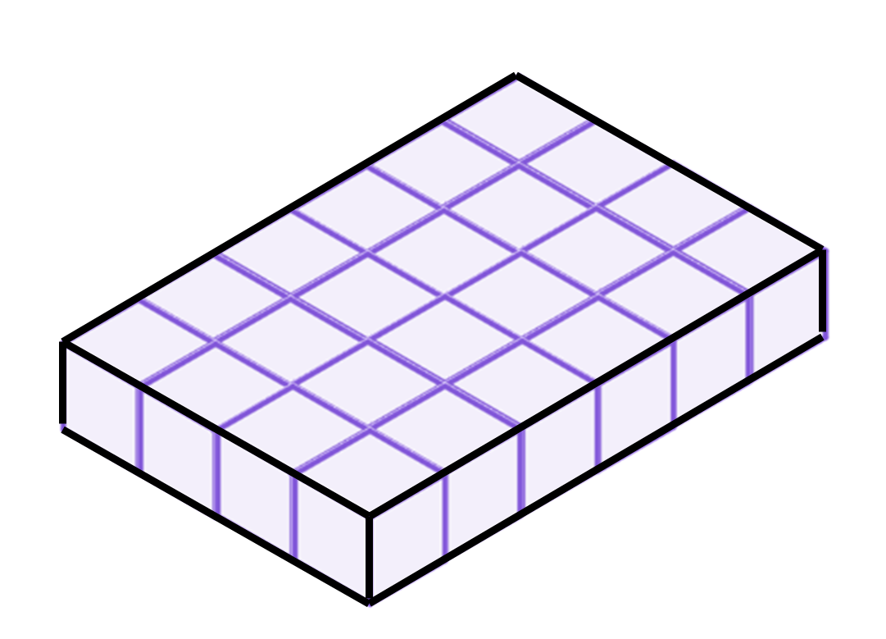
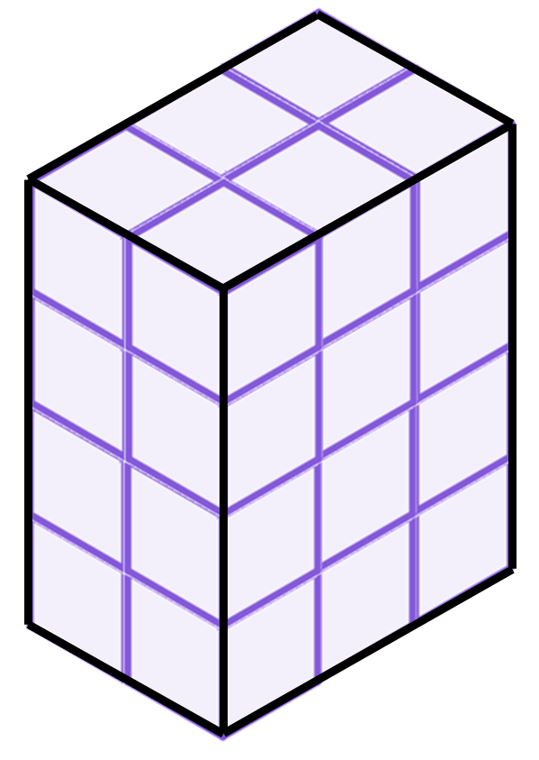
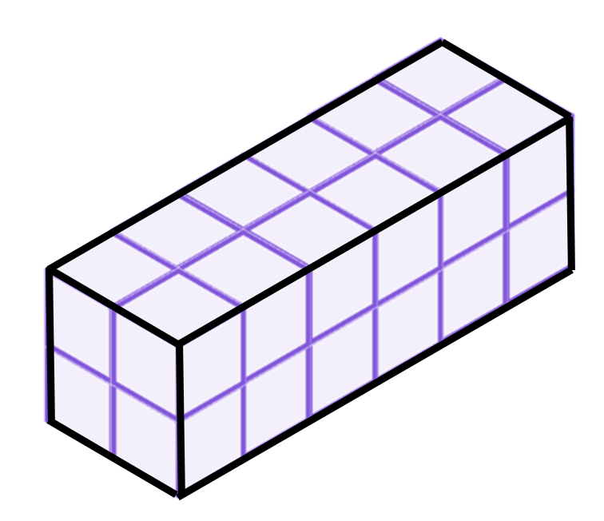
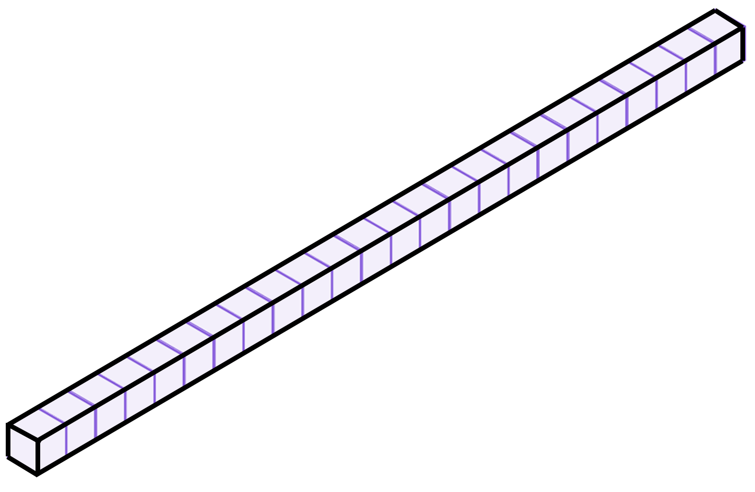
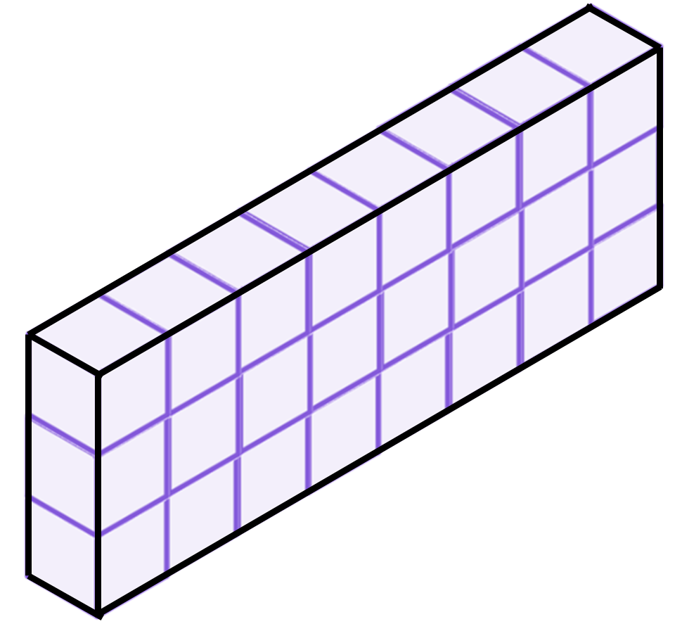
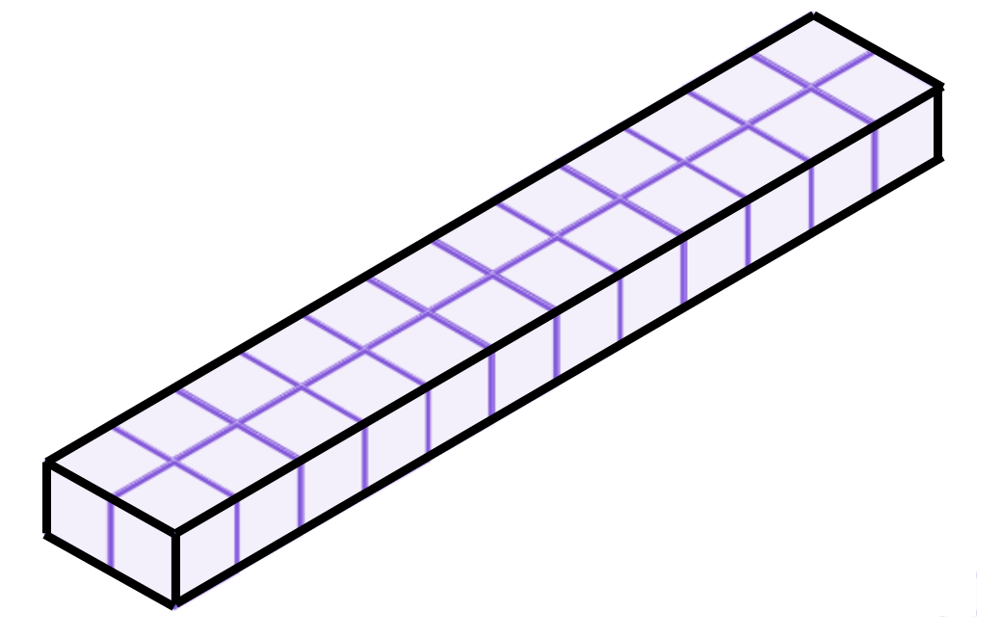
Calculating the volume of any prism
These cuboids are all made from 24 cubes.

Slide 11
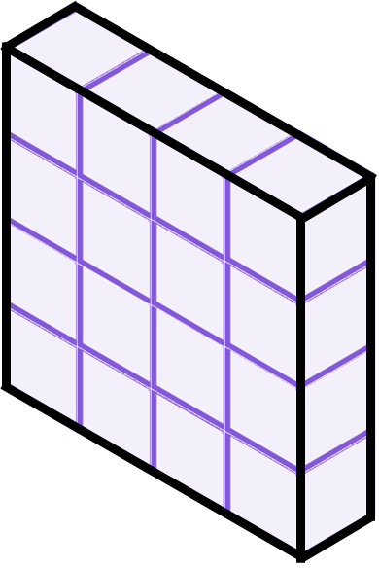
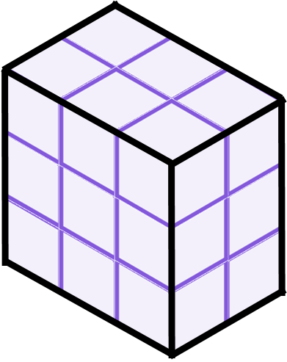
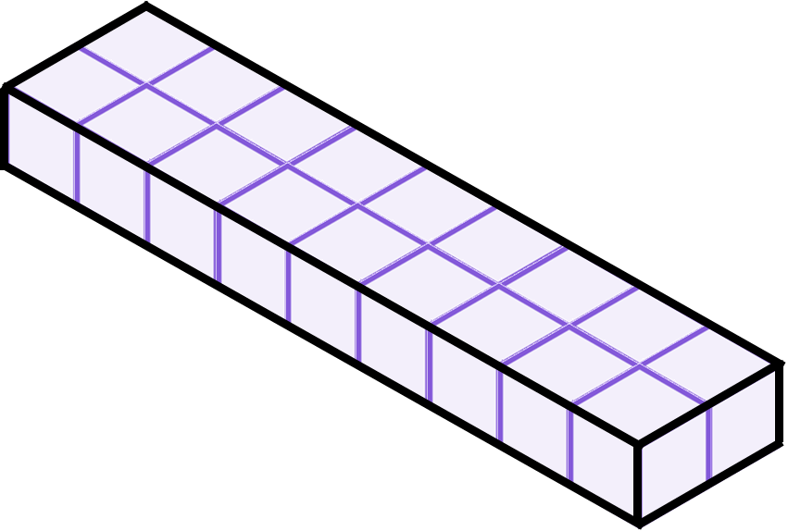

Calculating the volume of any prism
Which of these cuboids is made of 18 cubes?

Slide 12
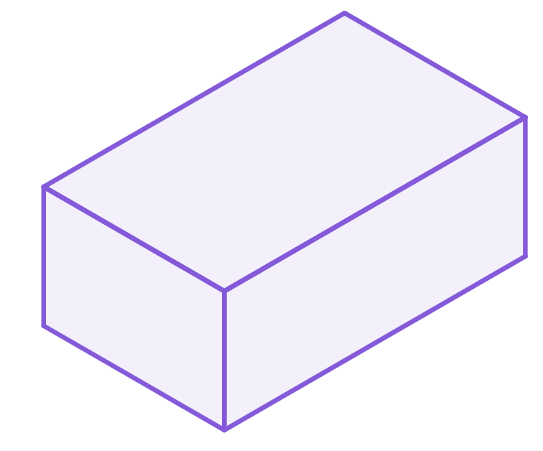
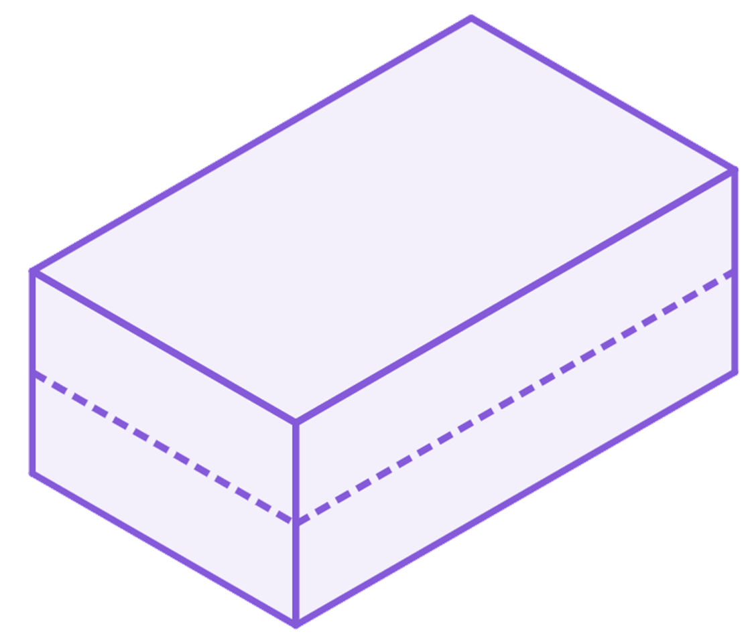
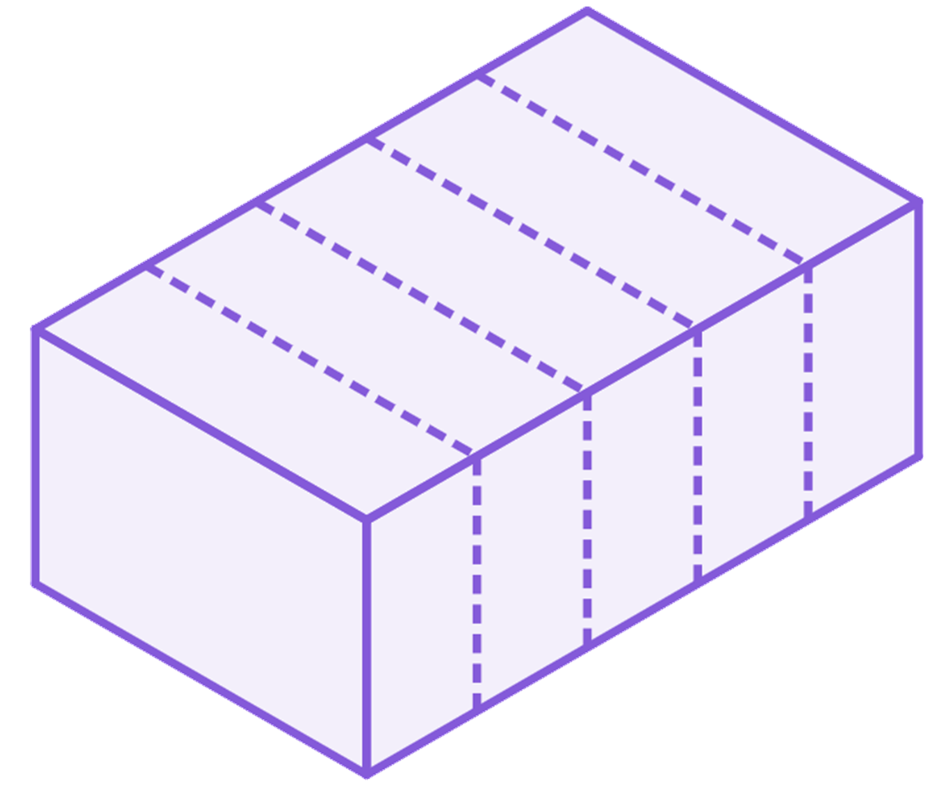
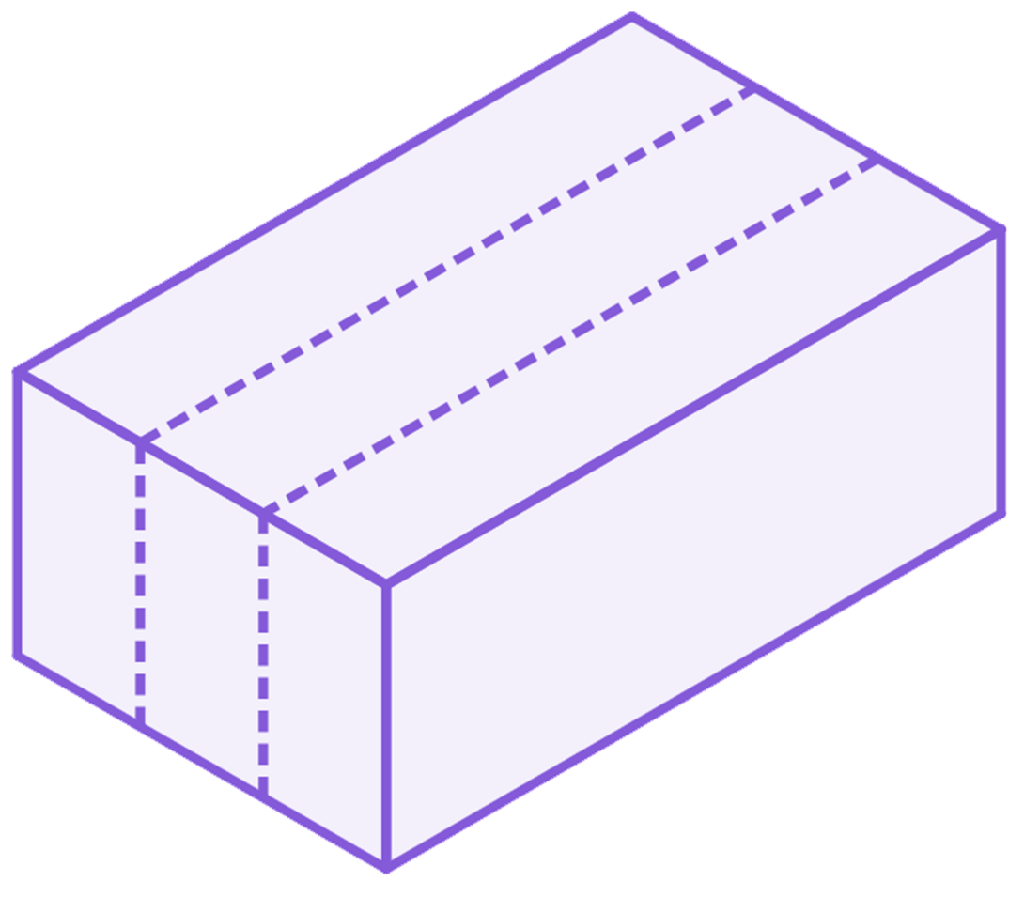

Calculating the volume of any prism
How many cubes have made this cuboid?
It can be thought of as 2 layers of 15 cubes.
It can be thought of as 3 slices of 10 cubes.
It can be thought of as 5 slices of 6 cubes.
2 cubes
2 lots of 15 cubes
= 3 lots of 10 cubes
= 5 lots of 6 cubes
= 30 cubes
5 cubes
3 cubes
Alex

Slide 13
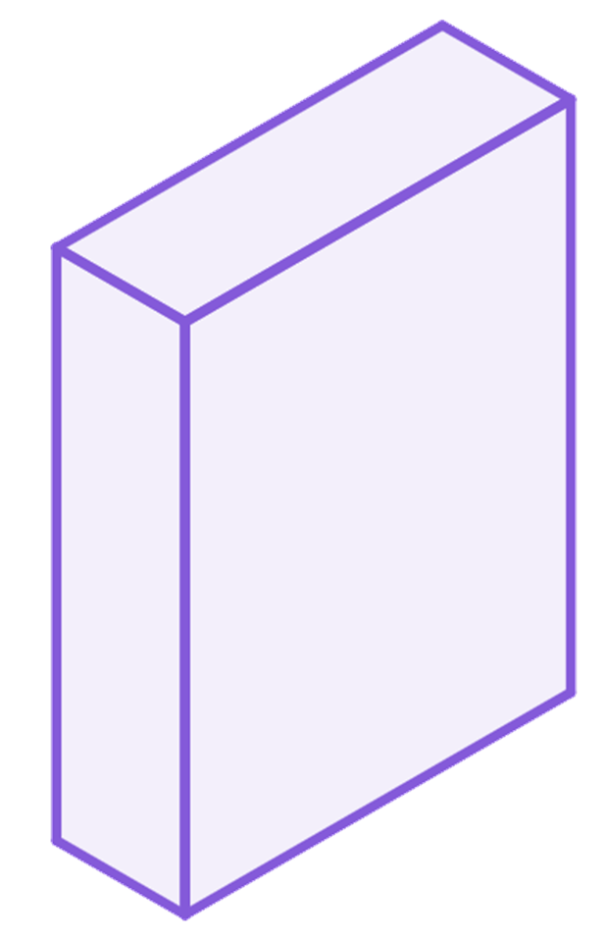
Calculating the volume of any prism
How many cubes would be needed to make this cuboid?
216 cubes
12 cubes
108 × 2 = 24 × 9 = 18 × 12
9 cubes
2 cubes

Slide 14
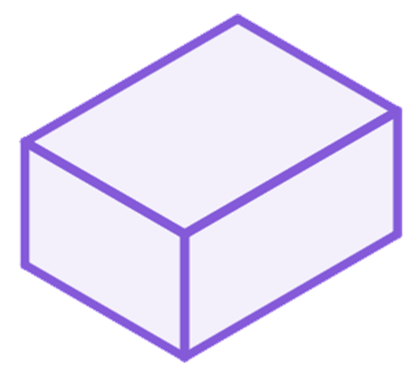
Calculating the volume of any prism
Volume is the amount of 3D space that is taken up by a shape.
Finding the volume of a shape always involves multiplying together three perpendicular lengths somewhere within the calculation.
Volume is measured in cubed units.
Examples of units:
km³, m³, cm³, mm³
miles³, feet³, inches³

Slide 15
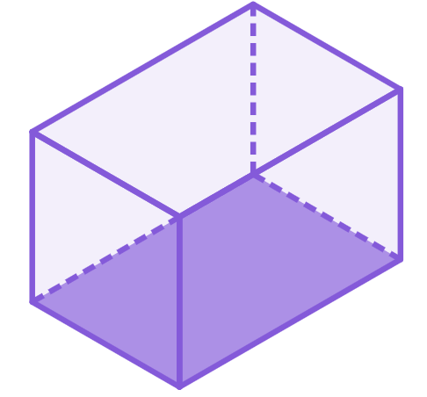
Calculating the volume of any prism
If each cube is 1 cm³, what is the volume of the cuboid?
A single layer would be 3 × 5 = 15 cubes (so a volume of 15 cm³)
3 cubes
There would be 3 layers
15 × 3 = 45 cubes
3 cubes
5 cubes
Volume = 45 cm³

Slide 16


Calculating the volume of any prism
Jun and Sofia are discussing how to calculate the volume of any prism.
A prism has a uniform cross-section throughout the length of it.
Yes, a cuboid has a rectangular cross-section.

Slide 17
Calculating the volume of any prism
To find the volume of a cuboid, you find the area of the rectangle and then multiply it by the height.
If it were a triangular prism, it is layers of triangles.

Slide 18
Calculating the volume of any prism
So to find the volume of a triangular prism, find the area of the triangle and then multiply it by the perpendicular distance between the bases?
Yes, the perpendicular distance is sometimes called the height or length depending on how it is presented.

Slide 19
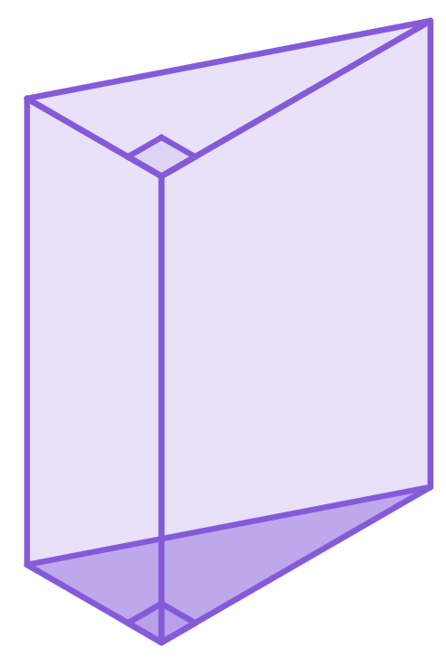
Calculating the volume of any prism
What would the volume of this triangular prism be?
The area of the base is 6 cm².
There are 8 centimetre deep layers, each with a volume of 6 cm³.
The volume is 8 × 6 = 48 cm³
8 cm
3 cm
4 cm

Slide 20
Calculating the volume of any prism
Yes! Prisms have a constant cross-section so multiplying by the length is including how many of those 1 unit deep layers there are. This works even if there aren’t whole numbers of 1 unit deep layers.
So extending this to any prism - the volume will be the area of the cross-sectional face multiplied by the length.

Slide 21
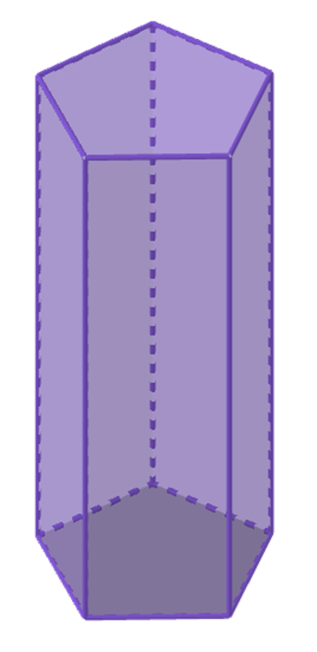
Calculating the volume of any prism
What would the volume of this pentagonal prism be?
12 cm²
Volume = 12 × 8 = 96 cm³
8 cm

Slide 22
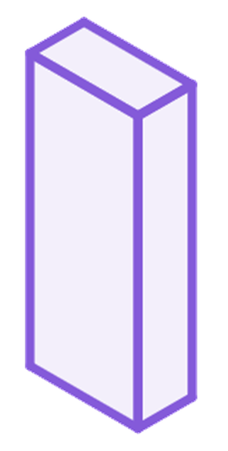
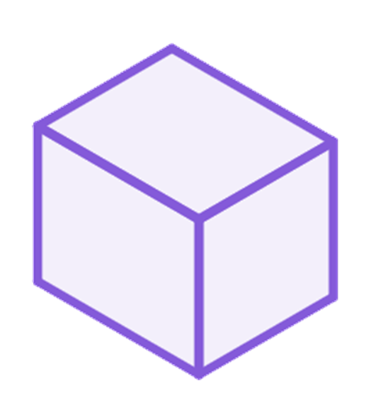
Calculating the volume of any prism
1) Sketch all the cuboids with integer lengths that have a volume of 18 cm³.
2) Calculate the volume of these cuboids.
a)
b)
2 cm
c)
4 cm
3.2 m
2 cm
50 mm
3.2 m
3 cm
4 m
1 cm

Slide 23
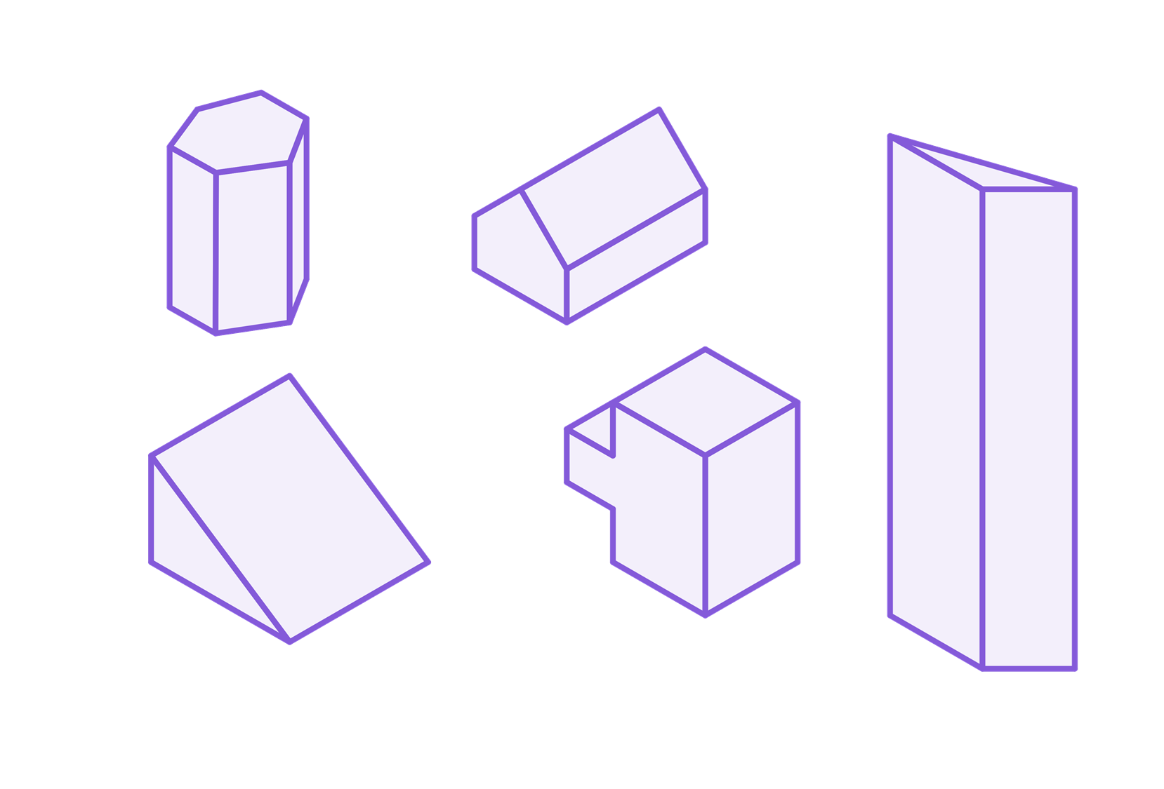
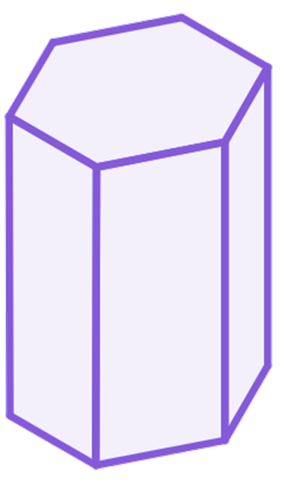
Calculating the volume of any prism
3) There are pairs of shapes with the same volume. Which shape does not have a pair?
Area
= 3 cm²
2 cm
1 cm
2 cm
1 cm
1 cm
4 cm
1 cm
3 cm
3 cm
1 cm
2 cm
2 cm
14 cm
2 cm
3 cm
3 cm
2 cm

Slide 24
Calculating the volume of any prism
1) Sketch all the cuboids with integer lengths that have a volume of 18 cm³.
There are four cuboids with integer lengths:
1 × 1 × 18
1 × 2 × 9
1 × 3 × 6
2 × 3 × 3

Slide 25
Calculating the volume of any prism
2) Calculate the volume of these cuboids.
a)
b)
2 cm
c)
4 cm
3.2 m
2 cm
50 mm
3.2 m
= 5 cm
3 cm
4 m
1 cm
3 × 2 × 4 = 24 cm³
5 × 2 × 1 = 10 cm³
4 × 3.2 × 3.2
= 40.96 m³

Slide 26
Calculating the volume of any prism
3) There are pairs of shapes with the same volume. Which shape does not have a pair?
Area
= 3 cm²
2 cm
9 cm³
1 cm
2 cm
1 cm
1 cm
4 cm
1 cm
3 cm
3 cm
1 cm
2 cm
2 cm
12 cm³
14 cm³
14 cm
9 cm³
2 cm
14 cm³
3 cm
3 cm
2 cm

Slide 27
Volume of prisms
Calculating the volume of any prism
Using the volume of a prism

Slide 28
Using the volume of a prism
If we know the area of the cross-section and the length then we can calculate the volume.
If we know the volume and the length of the prism, can we calculate the area of the cross-section?
Yes, we can use inverse operations to find the area of the cross-section.

Slide 29
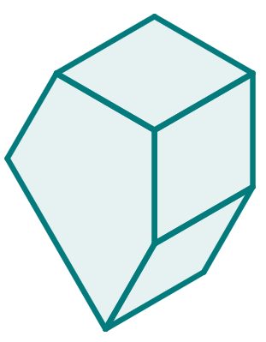
Using the volume of a prism
Volume of a prism = area of cross-section × length
8 m
344 = a × 8
344 = 8a
Area
= a m²
43 = a
Area of the pentagon is 43 m²
Volume = 344 m³

Slide 30

Using the volume of a prism
Work out the area of the ‘L shape’, given the length and volume of the prism.
302.5 = x × 24.2
302.5 = 24.2x
12.5 = x
24.2 cm
Area of the ‘L-shape’ is 12.5 cm²
Volume = 302.5 cm³

Slide 31
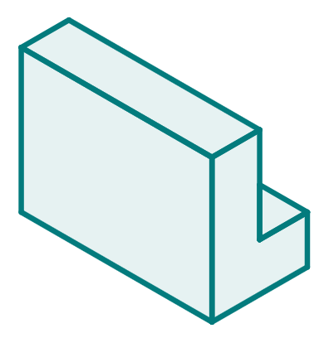
Using the volume of a prism
Volume of a prism = area of cross-section × length
Area
= 24 cm²
204 = 24 × l
204 = 24l
8.5 = l
l cm
The length is 8.5 cm
Volume = 204 cm³

Slide 32
Using the volume of a prism
Work out the height of the prism, given the area of the ‘L-shape’ and the volume.
379.6 = 52 × h
Area
= 52 cm²
379.6 = 52h
7.3 = h
h cm
Height of the prism is 7.3 cm
Volume = 379.6 cm³

Slide 33
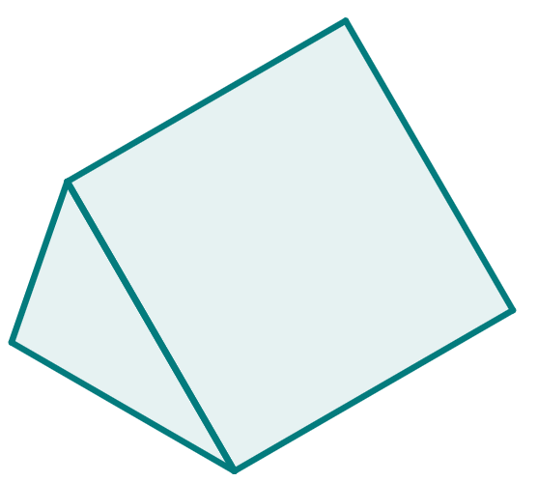
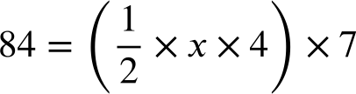
Using the volume of a prism
Volume of a prism = area of cross-section × length
4 cm
84 = 2x × 7
84 = 14x
6 = x
x cm
7 cm
The length is 6 cm
Volume = 84 cm³

Slide 34
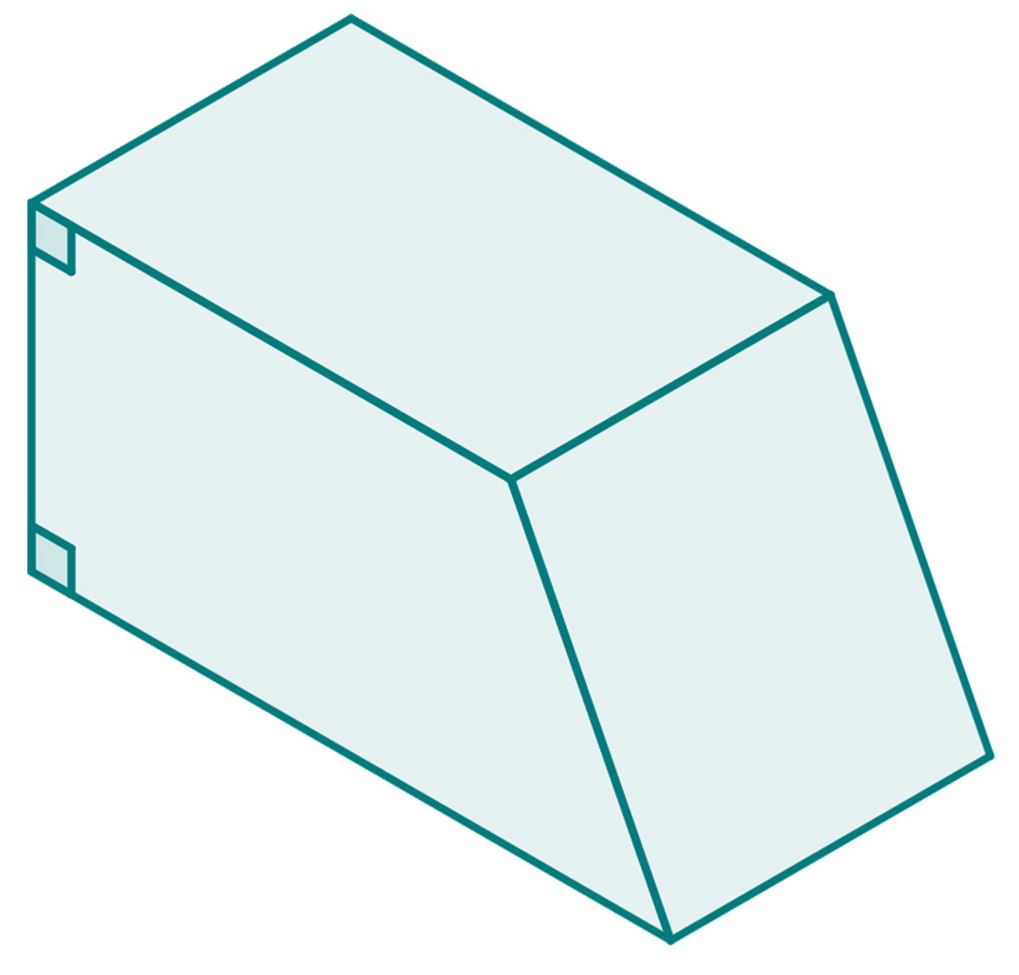
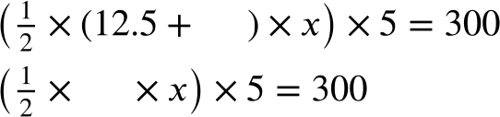
Using the volume of a prism
1) Complete the missing parts of the calculation.
7.5 m
x m
10x =
x =
12.5 m
5 m
Volume = 300 m³

Slide 35
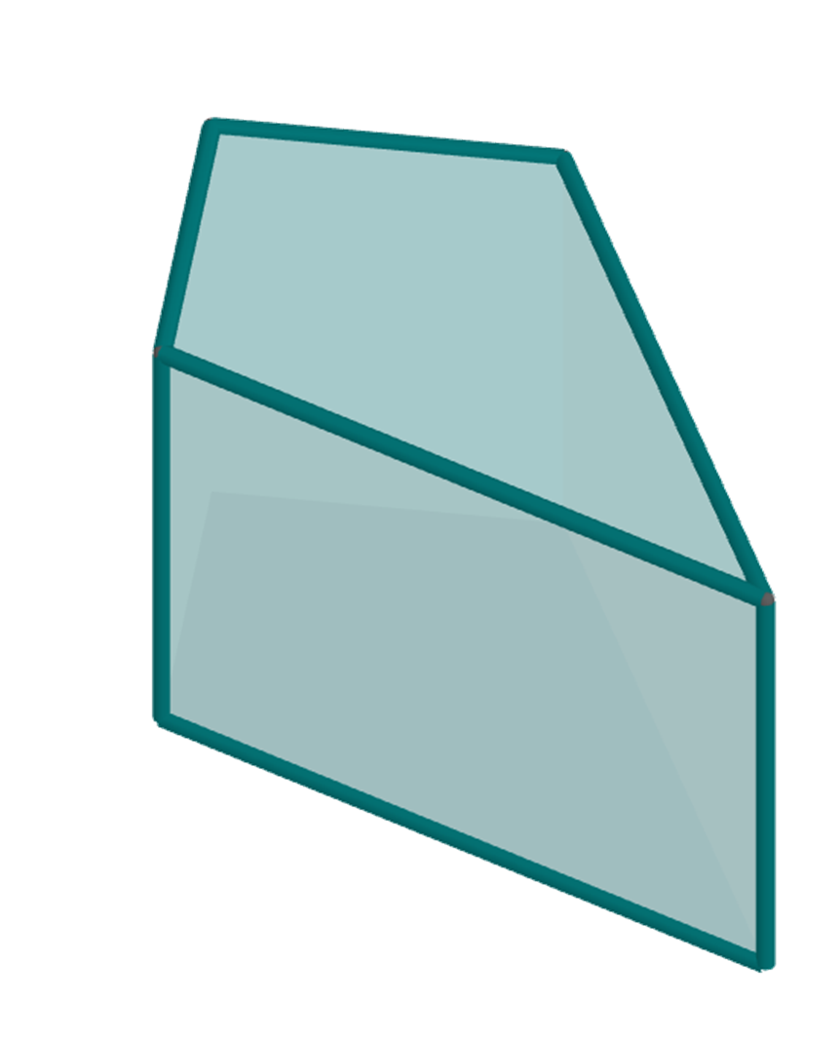
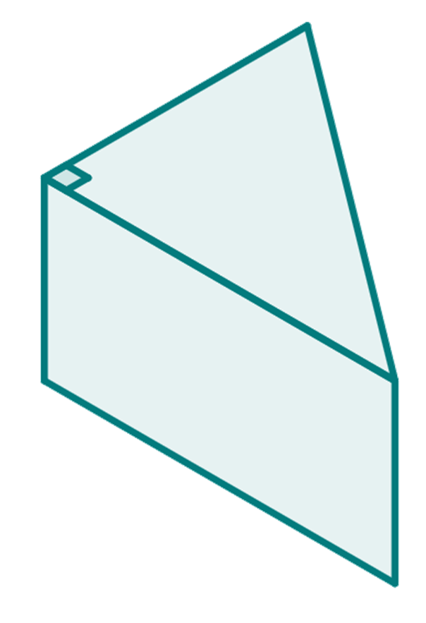
Using the volume of a prism
2) Both prisms have a volume of 378 mm³. Work out the missing length in each prism.
6 mm
a mm
21 mm
b mm
7 mm
12 mm

Slide 36
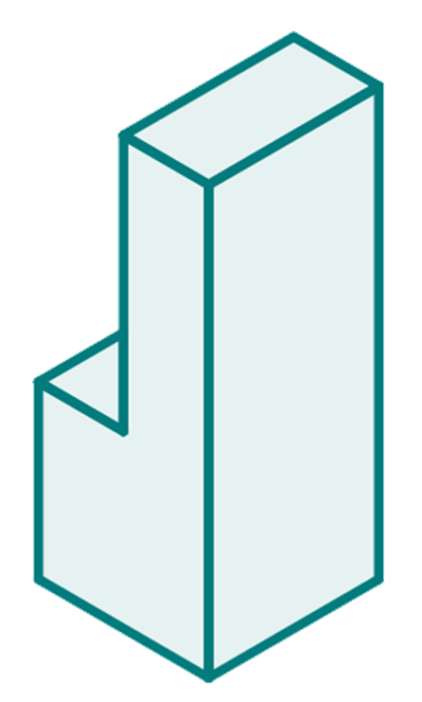
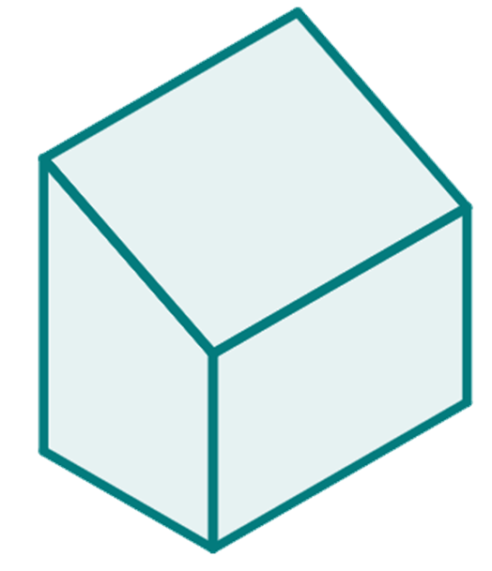
Using the volume of a prism
3) Prism A and prism B have the same volume. Work out the missing length of prism B.
3 cm
22 cm
B
12 cm
9 cm
8 cm
A
4 cm
15 cm
6 cm
x cm

Slide 37
Using the volume of a prism
1) Complete the missing parts of the calculation.
7.5 m
7.5
x m
20
10x =
60
x =
6
12.5 m
5 m
Volume = 300 m³

Slide 38
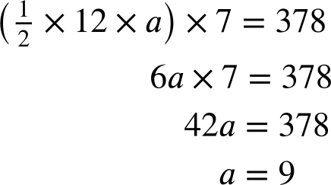
Using the volume of a prism
2) Both prisms have a volume of 378 mm³. Work out the missing length in each prism.
a mm
7 mm
12 mm

Slide 39
Using the volume of a prism
2) Both prisms have a volume of 378 mm³. Work out the missing length in each prism.
6 mm
21 × 6 × b = 378
21 mm
126b = 378
b = 3
b mm

Slide 40
Using the volume of a prism
3) Prism A and prism B have the same volume. Work out the missing length of prism B.
3 cm
22 cm
B
12 cm
9 cm
8 cm
A
4 cm
15 cm
6 cm
x cm

Slide 41
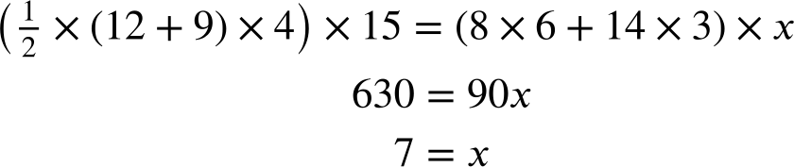
Using the volume of a prism
3) Prism A and prism B have the same volume. Work out the missing length of prism B.
Volume of prism A = volume of prism B

Slide 42
Volume of prisms
The volume of any prism is the product of the area of the cross-sectional face and the length of the prism.
You can use this relationship to find the volume if you know the area and length (or have enough information to find the area) or if you are given the volume can find missing areas or lengths.

Slide 43

© Oak National Academy 2023.
Produced in partnership with Mathematics in Education and Industry.
Licensed on the Open Government Licence v3.0, except where otherwise stated. See Oak terms and conditions.

